Slide 1

AGE 310: Instrumentation and Measurements
Lecture 2: Measurement Standards & Signals
Instructor: Dr. Kadeghe Fue
Department of Agricultural Engineering
Sokoine University of Agriculture (SUA)

Slide 2


Recap & Objectives
Recap: Lecture 1
Lecture 2 Objectives
We defined the Generalized Measurement System (GMS) and distinguished between static characteristics (Accuracy, Precision) and dynamic characteristics.
Understand the hierarchy of measurement standards.
Define "Traceability" and its importance.
Differentiate between Analog and Digital signals.
Analyze signal transmission methods (Voltage vs Current loops).

Slide 3

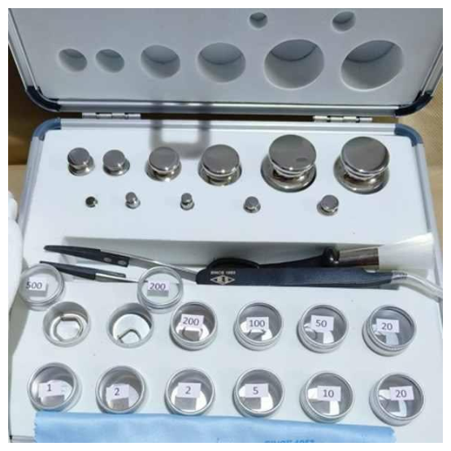
Measurement Standards
What is a Standard?
A standard is a physical representation of a unit of measurement. It is the "source of truth" for calibration.
For example, when we calibrate a balance in the lab, we use a set of standard weights that have a known, certified mass.
Key Concept: Without standards, data from different locations cannot be compared.

Slide 4

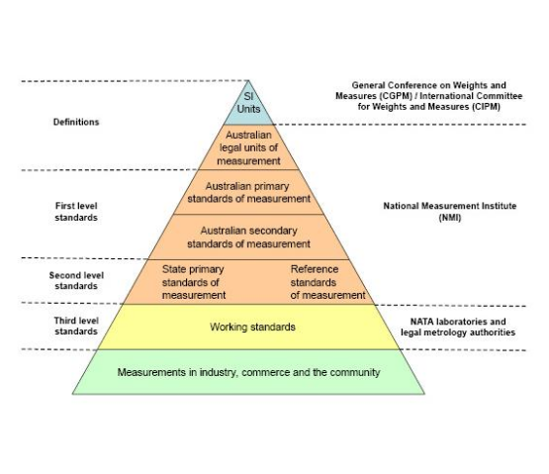
The Hierarchy of Standards
Standards are organized in a strict pyramid of accuracy:
International Standards: Maintained by BIPM (France). Highest accuracy.
Primary Standards: Maintained by National Metrology Institutes (e.g., TBS in Tanzania, NIST).
Secondary Standards: Used by industrial labs for reference.
Working Standards: Used daily in our workshops and fields.

Slide 5







Traceability
Traceability is the property of a measurement whereby the result can be related to a reference through an unbroken chain of calibrations.
The Chain
Global Acceptance
Certification
Field Sensor → Lab Calibrator → National Standard → SI Unit.
Ensures that 1 kg of maize in Morogoro is recognized as 1 kg in Dar es Salaam or London.
Every calibration certificate must list the standards used to prove this link.

Slide 6

Introduction to Signals
Once a sensor detects a physical variable (Temperature, Pressure), it converts it into a signal for transmission.
Analog Signals
Digital Signals
Continuous signals where the variable is represented by a continuously varying voltage or current.
Discrete signals where information is represented by a sequence of discrete values (0s and 1s).
Computers and microcontrollers are digital.
Nature is analog (temperature doesn't "jump" steps).

Slide 7
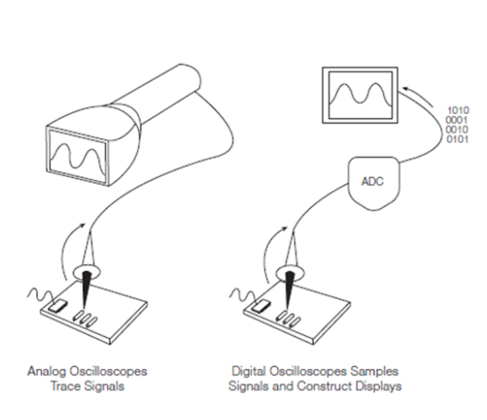
Analog Signals
Characteristics
Continuous: Infinite resolution (theoretically).
Real-time: Instantaneous representation of the physical event.
Vulnerability: Highly susceptible to noise and degradation over long cables.
Example: A thermocouple generating millivolts corresponding to heat.

Slide 8



Digital Signals
Discrete State
Noise Immunity
Storage
The signal is either High (1) or Low (0). There is no ambiguity in the value.
It is very easy to distinguish a "1" from a "0", even if there is some electrical noise.
Digital data is easily stored, copied, and transmitted without loss of quality.

Slide 9
Comparison: Analog vs. Digital
Feature | Analog Signal | Digital Signal
Continuity | Continuous in time and amplitude | Discrete (Steps)
Resolution | High (Infinite) | Limited by bit-depth (e.g., 8-bit, 12-bit)
Noise Sensitivity | High (Noise distorts data) | Low (Thresholds filter noise)
Example | Mercury Thermometer | Smart Weather Station

Slide 10


Signal Transmission
How do we move data from the field (sensor) to the control room?
Two main standards in instrumentation:
Voltage Signal
Current Signal
0-10 VDC
4-20 mA
Prone to voltage drop over long wires.
The Industry Standard.

Slide 11
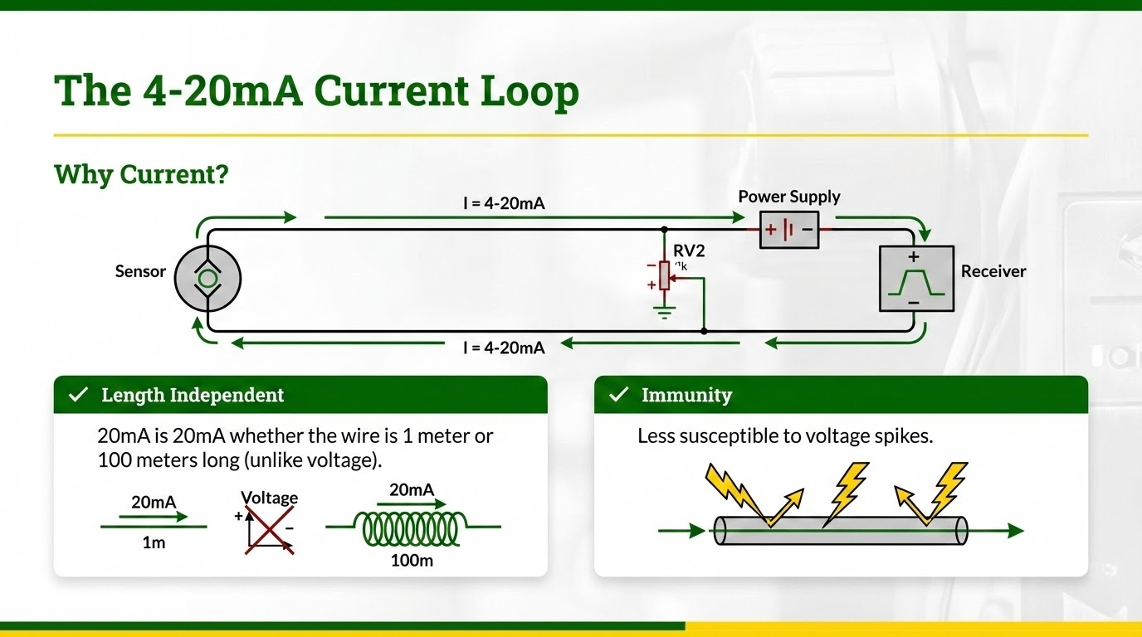

Slide 12
Concept of "Live Zero"
Why 4mA and not 0mA?
Fault Detection
In a 4-20mA system, 4mA represents 0% of the measured value (e.g., empty tank).
If the current drops to 0mA, we know the wire is broken or the sensor has failed.
This is called a "Live Zero".
If the range started at 0mA, we wouldn't know if the tank was empty or the wire was cut.

Slide 13
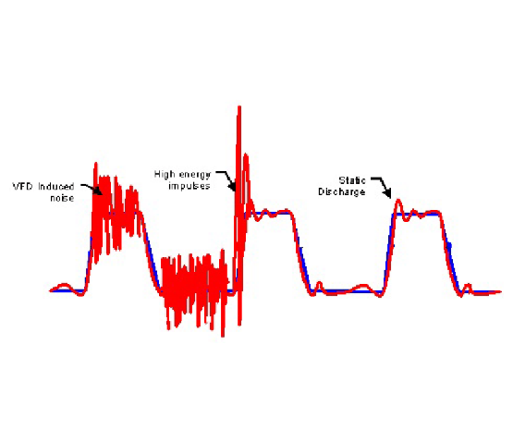


Signal Noise (SNR)
Signal-to-Noise Ratio
Noise is unwanted energy that interferes with the desired signal. It comes from thermal agitation, magnetic fields (motors), or radio waves.
We want a HIGH SNR.

Slide 14
Reducing Noise in Agriculture
Shielding: Using cables with a grounded metal foil wrap to block Electromagnetic Interference (EMI) from tractor engines.
Twisted Pairs: Twisting wires cancels out magnetic interference.
Filtering: Using capacitors or software algorithms to smooth out the jittery data.
Impedance Matching: Matching source and load resistance to prevent signal reflection.

Slide 15
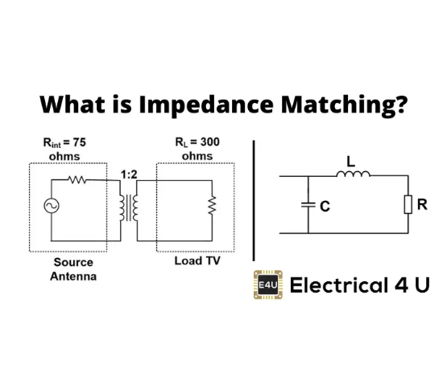
Impedance Matching
Max Power Transfer
To transfer the maximum amount of signal power from the sensor to the readout, the impedance (resistance) of the load must equal the source.
Mismatch leads to: Signal reflection (ghosting) and power loss. This is critical in high-frequency measurements like Radar or Ultrasonic sensing.

Slide 16
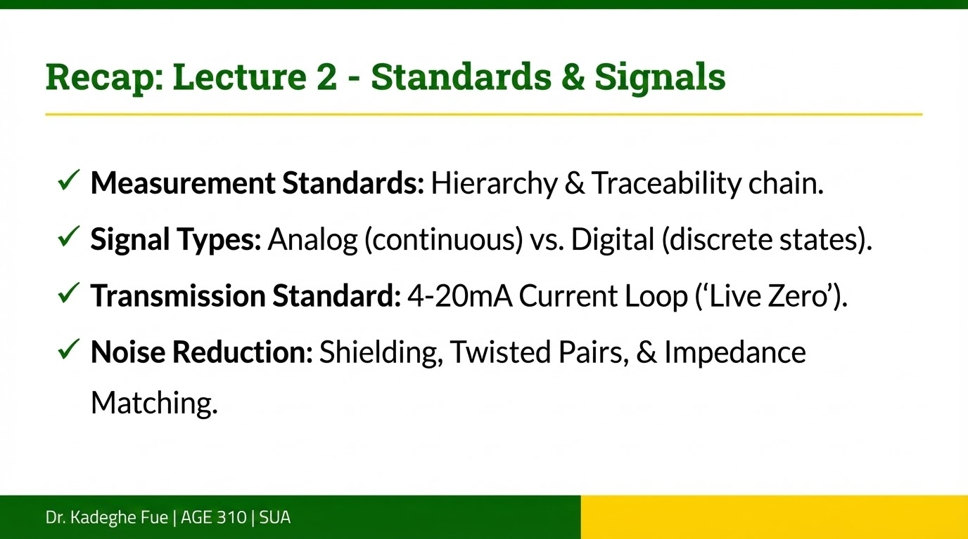

Slide 17

Questions?
End of Lecture 2
Next Class: We start looking at specific sensors, beginning with Resistive Transducers (Potentiometers and Strain Gauges).
Dr. Kadeghe Fue | AGE 310 | SUA

